Slide 1

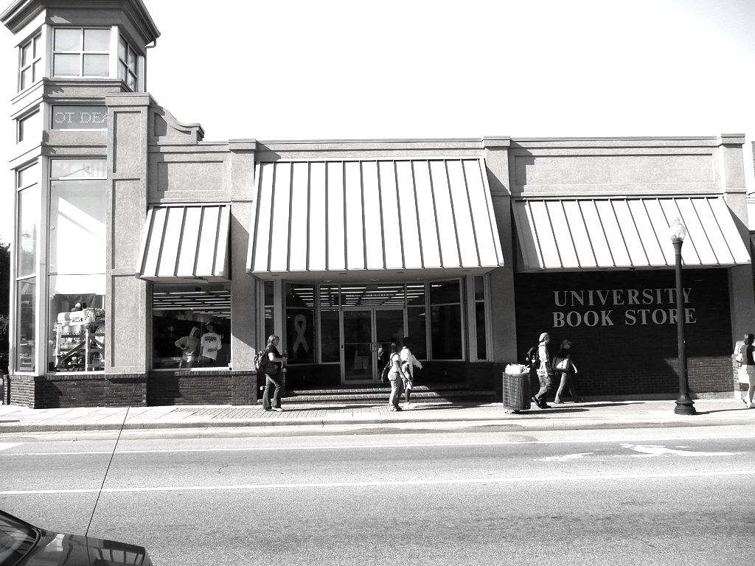

MGMT 582 FINAL PROJECT
Tvisha Goswami
Vedanti Gulalkari
Dae Sung Kim
Rishab Malhotra
Soham Patil

Slide 2
Agenda
Background
Objective Function
Entities Overview
ERD
Relational Schema
Normalization
Analysis using SQL queries
Possible Enhancements

Slide 3

Bookstore Background
Due to lack of proper database management, the bookstore has difficulty understanding its own inventory status, overstocking certain items and failing to restock popular products.

Slide 4
Objective Function
Inventory Management
Design an optimized database for the bookstore that will store the data in an organized way, prevent overstocking or stockout events, and provide visualize best-selling items and customer habits.

Slide 5
Major Entities under Consideration
INVENTORY
BOOKSTORE
CUSTOMER
VENDOR
EMPLOYEE

Slide 6

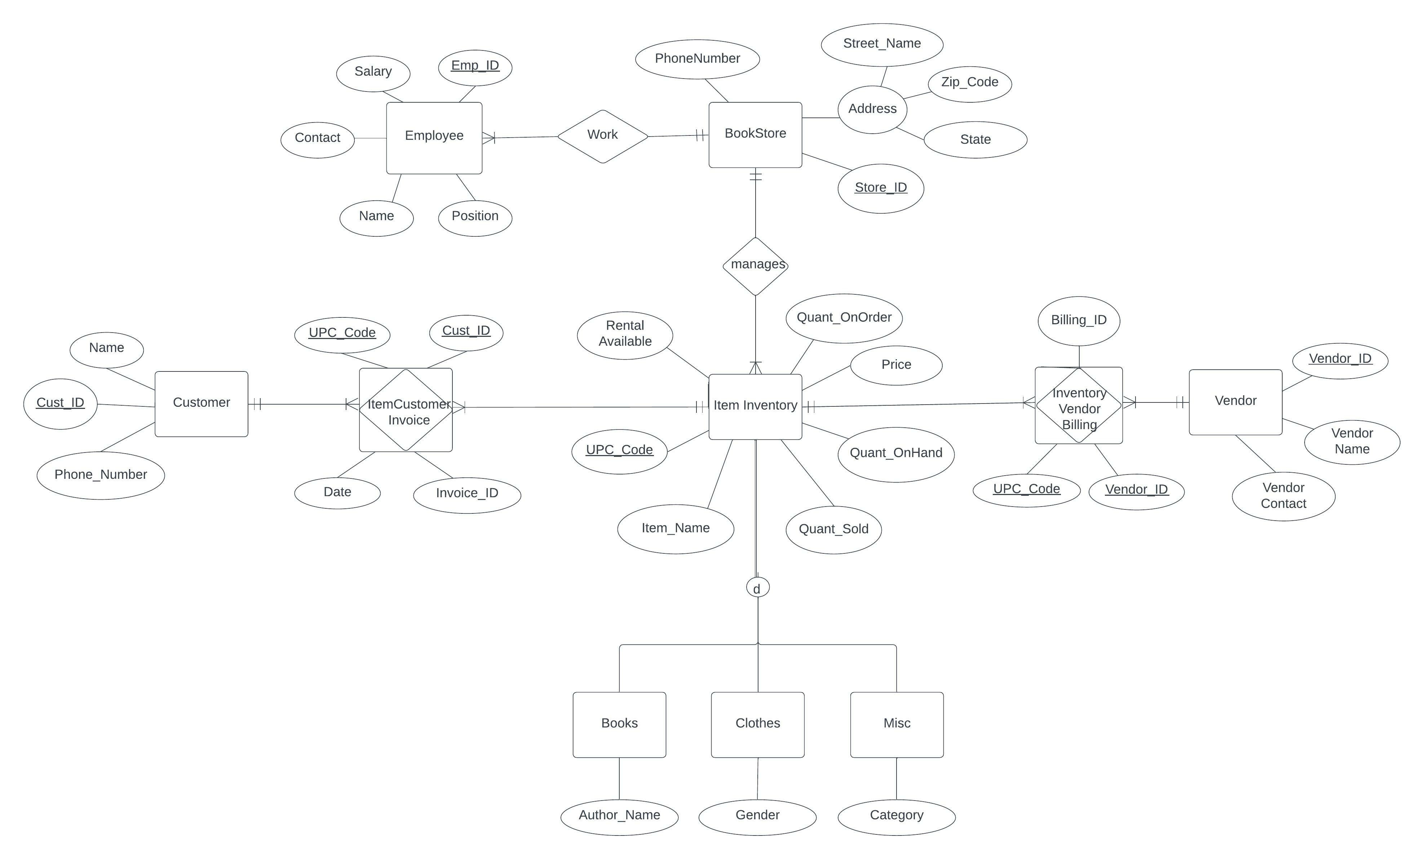
Entity Relationship Diagram

Slide 7
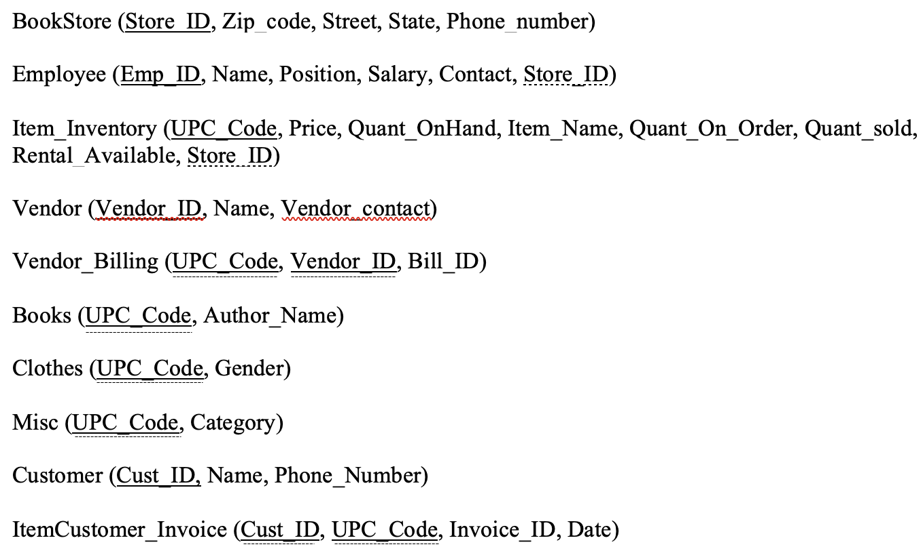
Relational Schema

Slide 8
Normalization
1-NF
2-NF
3-NF
The Book-Store table contains composite key – Address. To implement 1NF, we will break down address to include Street, State and Pin-Code columns independently instead of one Address column.
The tables are now in 1-NF and they do not possess any partial functional dependency. Hence, table is in 2-NF.
There is no transitive functional dependency in the dataset and hence the tables are in 3-NF.

Slide 9

MySQL Application
Queries for the Bookstore

Slide 10
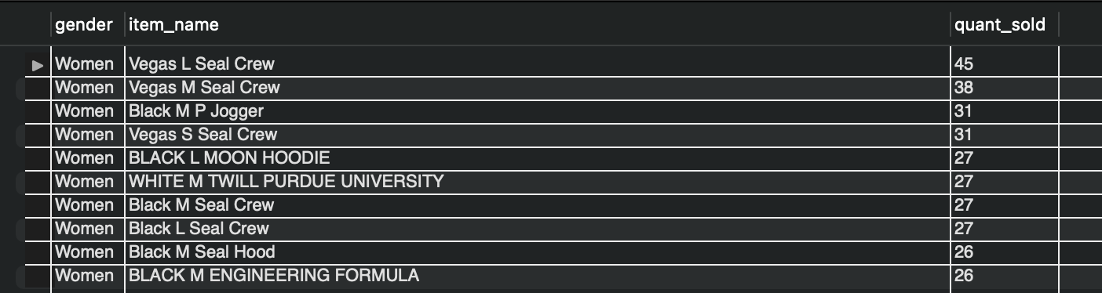
Scenario 1: Customer Analysis
Gender-wise popular products
Query: Join Table Inventory and Clothes and Group By Gender, Item Name, Quantity Sold

Slide 11
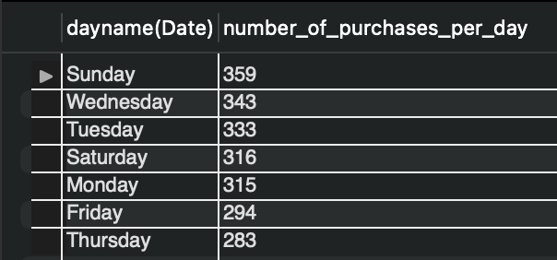
Scenario 1: Customer Analysis
Popular weekday for the buyer
Query: Use datetime concept on the group by date and order by number of purchases per day

Slide 12
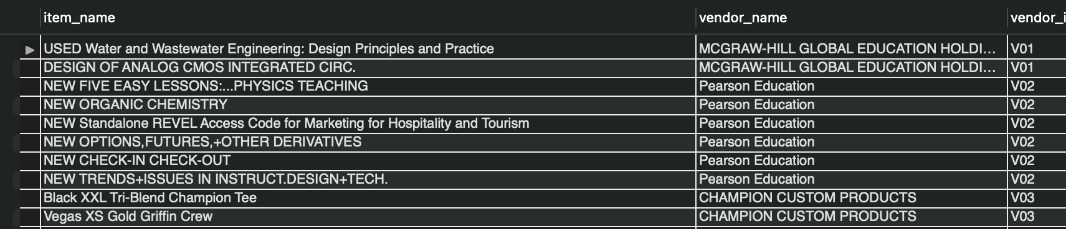
Scenario 2: Vendor Analysis
One Vendor One Invoice
Query: Join on Inventory and Vendor and filter by various quantity measures

Slide 13
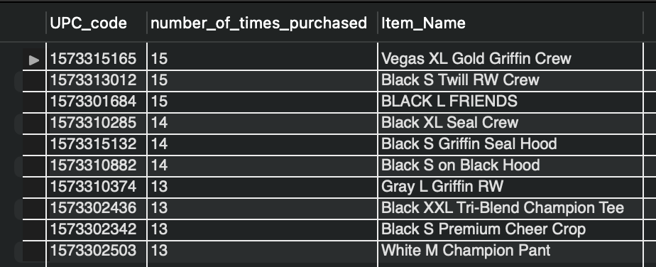
Scenario 3: Inventory Replenishment
Best Selling Items
Query: Join Invoice and Inventory and order by various purchasing parameters

Slide 14
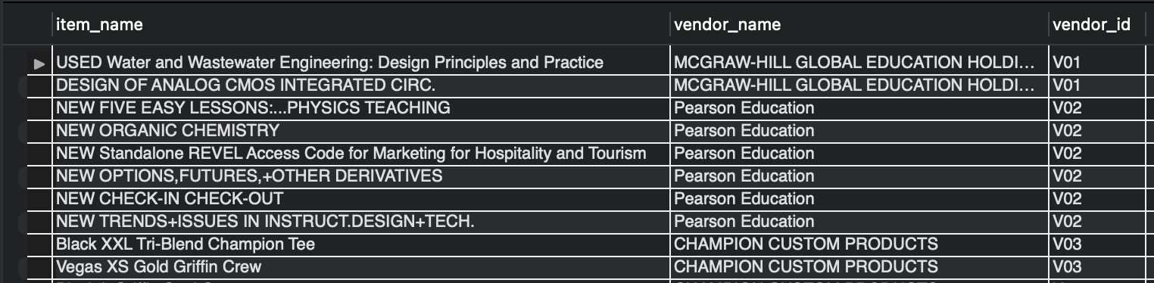
Scenario 3: Inventory Replenishment
When to restock
Query: Join Inventory and Vendor Data to figure out the items whose current quantity on hand is zero and current quantity in order is also zero

Slide 15
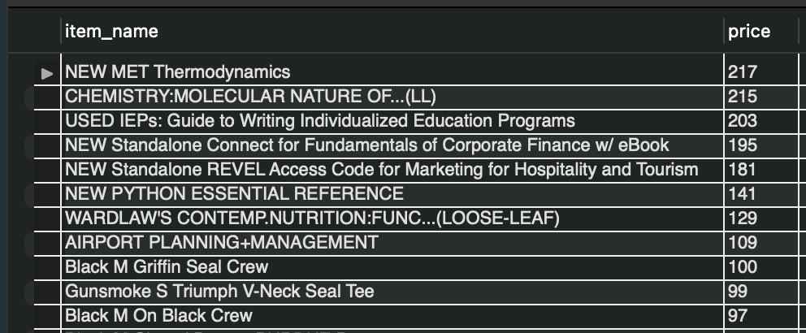
Scenario 4: Inventory Management
Restock Alert for Best-Sellers
Query: Create a quantity threshold for 20% of stock for top 50 items and then check for item quantities below threshold

Slide 16
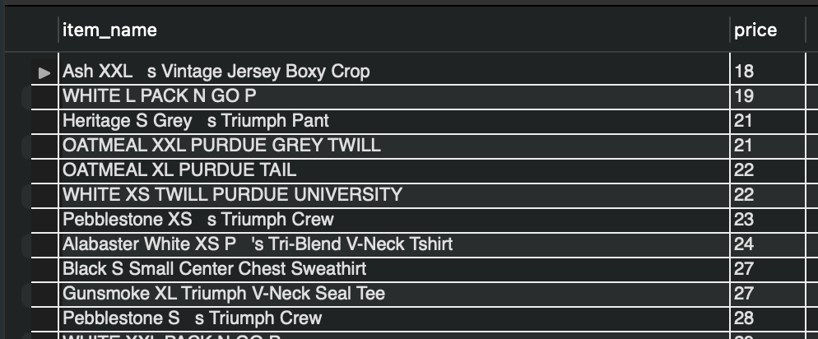
Scenario 4: Inventory Management
Restock Alert for Below Average Sellers
Query: Less stock threshold value needs to be maintained for the items with less sales

Slide 17
Possible Enhancements
Use Bookstore Entity for Expansion
Inventory Management on Bookstore Level
Strong backend for enhancing further digital presence through website/mobile application

Slide 18
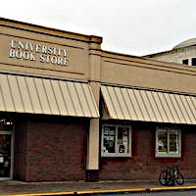
THANK YOU!

